Slide 1



ABP v8.2 & Community News
Engincan VESKE
Software Engineer at Volosoft

Slide 2

Overall
https://blog.abp.io/abp/announcing-abp-8-2-release-candidate
New Features:
Blazor Full-Stack Web App UI
Introducing the IBlockUiService for Blazor UI
Case-Insensitive Indexes for MongoDB
Session Management
Suite: File/Image Property
Suite: DateOnly & TimeOnly Types
Periodic Log Deletion for Audit Logs
Community News

Slide 3
Blazor Full-Stack Web App UI
ASP.NET Blazor in .NET 8 allows you to use a single powerful component model to handle all of your web UI needs, including server-side rendering, client-side rendering, streaming rendering, progressive enhancement, and much more…
ABP v8.2.x supports the new Blazor Web App template, which you can directly created from either Suite or CLI with the following command:
abp new BookStore -t app -u blazor-webapp

Slide 4
Blazor Full-Stack Web App UI
When you create the project, you will typically see two main projects for Blazor UI, besides other projects:
*.Blazor (startup project of your application and contains the App.razor component, which is the root component of your application)
*.Blazor.Client
Notes:
You can imagine this new web UI as a combination of both Blazor Server & Blazor WASM and it’s main propose is to overcome the disadvantages of these two UI technologies.

Slide 5
IBlockUiService for Blazor UI
//Inject the IBlockUiService private readonly IBlockUiService _blockUiService; public MyClass(IBlockUiService _blockUiService) { _blockUiService = blockUiService; }
//Blocking the element await _blockUiService.Block(selectors: "#MySelectors", busy: true); //Unblocking the element await _blockUiService.UnBlock(selectors: "#MySelectors");

Slide 6
Case-Insensitive Indexes for MongoDB
protected override void CreateModel(IMongoModelBuilder modelBuilder) { base.CreateModel(modelBuilder); modelBuilder.Entity<Question>(b => { b.CreateCollectionOptions.Collation = new Collation(locale:"en_US", strength: CollationStrength.Secondary); b.ConfigureIndexes(indexes => { indexes.CreateOne( new CreateIndexModel<BsonDocument>( Builders<BsonDocument>.IndexKeys.Ascending("MyProperty"), new CreateIndexOptions { Unique = true } ) ); } ); }); }
https://docs.abp.io/en/abp/8.2/MongoDB#configure-indexes-and-createcollectionoptions-for-a-collection

Slide 7
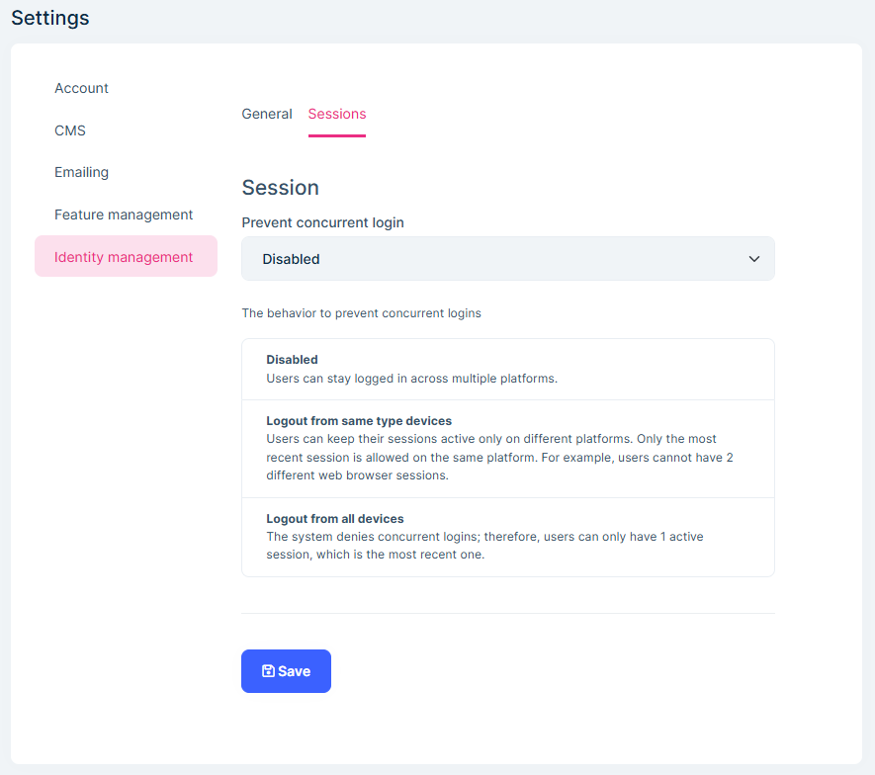
Session Management
Prevents concurrent login
From same type of devices
From all devices (mobile, web, etc…)
Or disable it completely (allow concurrent login)
Allows to manage user sessions
https://docs.abp.io/en/commercial/8.2/modules/identity/session-management

Slide 8
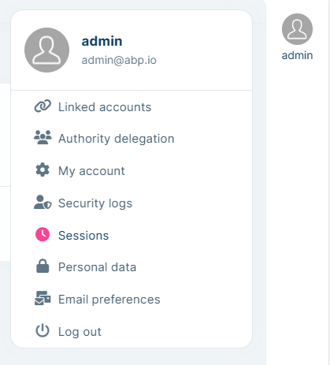
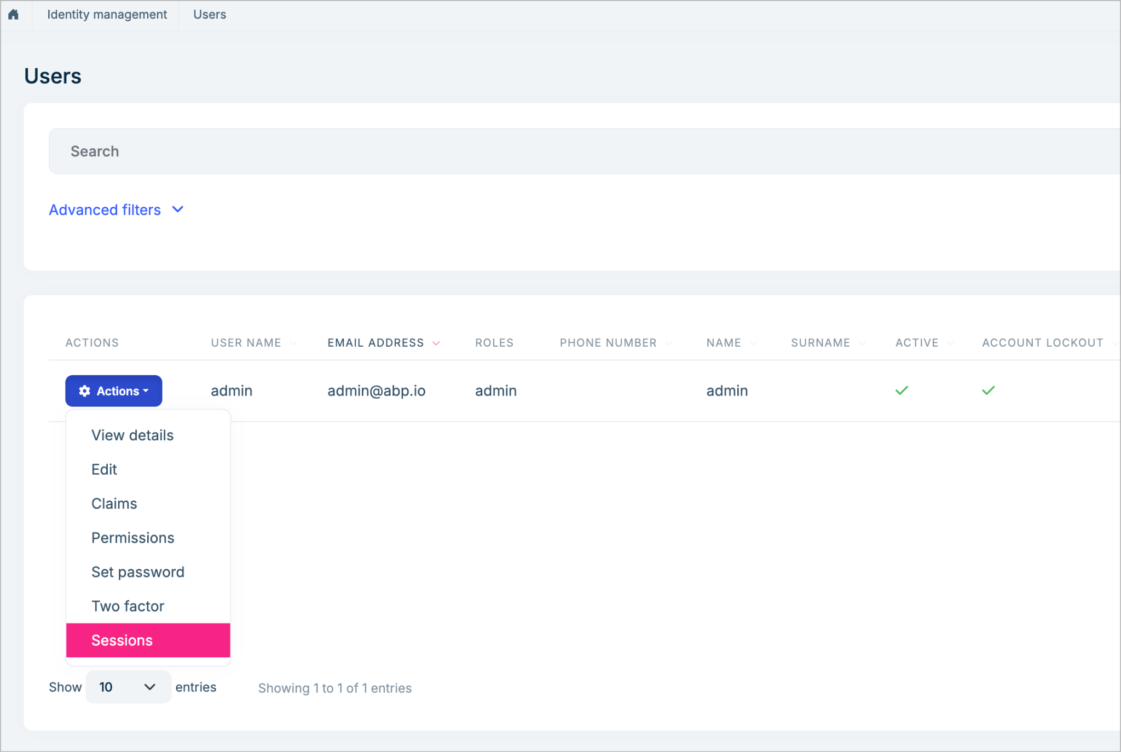

Slide 9
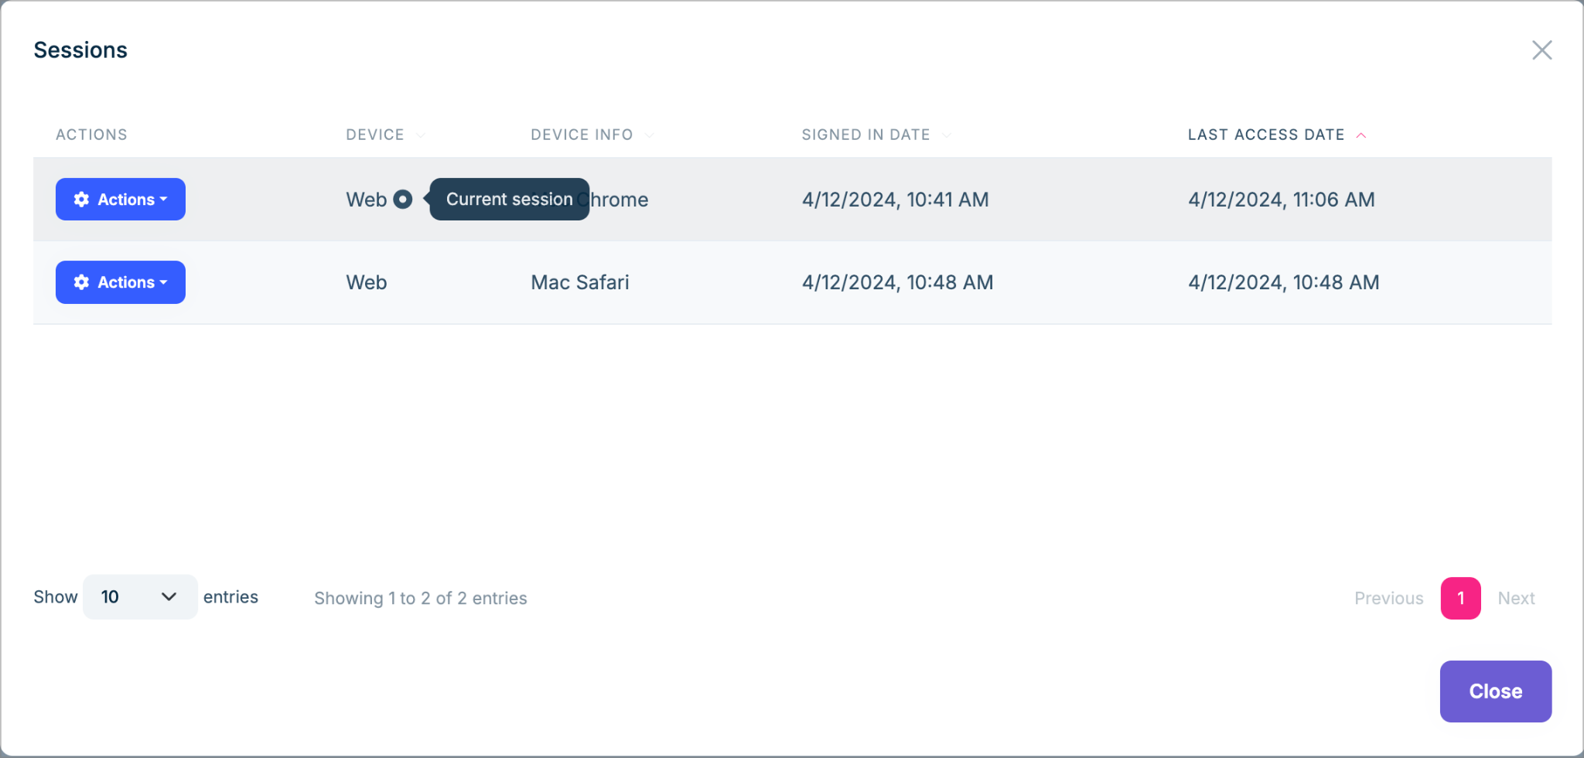

Slide 10


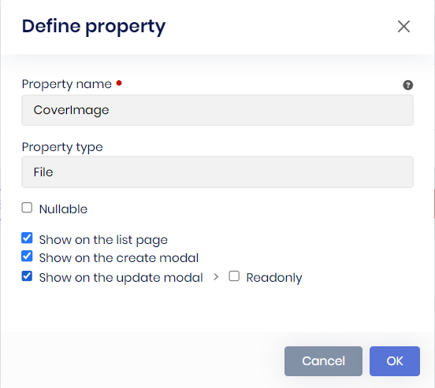

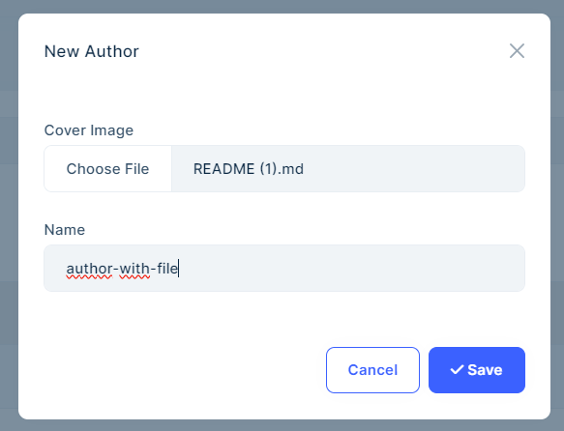
Suite: File/Image Property

Slide 12
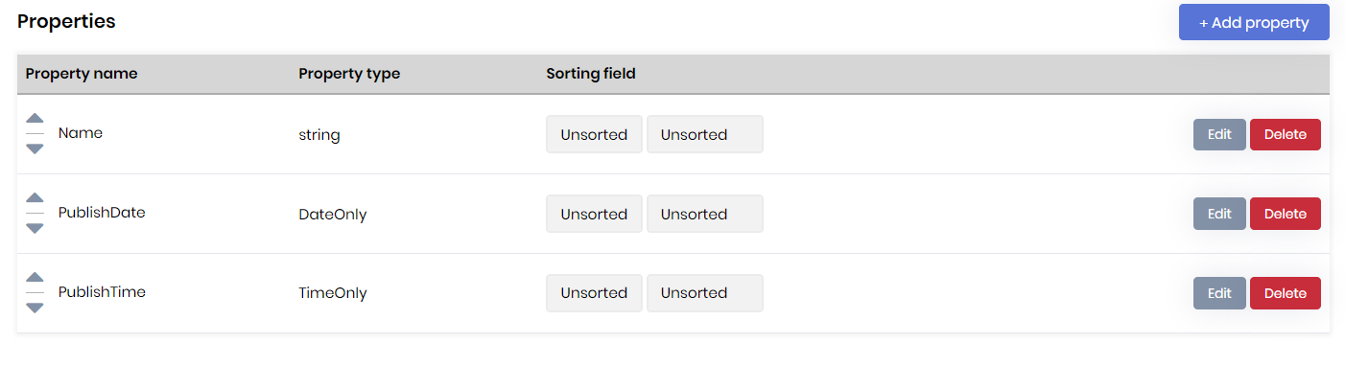
Suite: DateOnly & TimeOnly Types
Note: The DateOnly and TimeOnly structures were introduced with .NET 6. With ABP v8.2, all startup templates target single target framework, so if you created your project before ABP v8.2, please make sure that all of your projects’ target frameworks are .NET 8+.

Slide 13
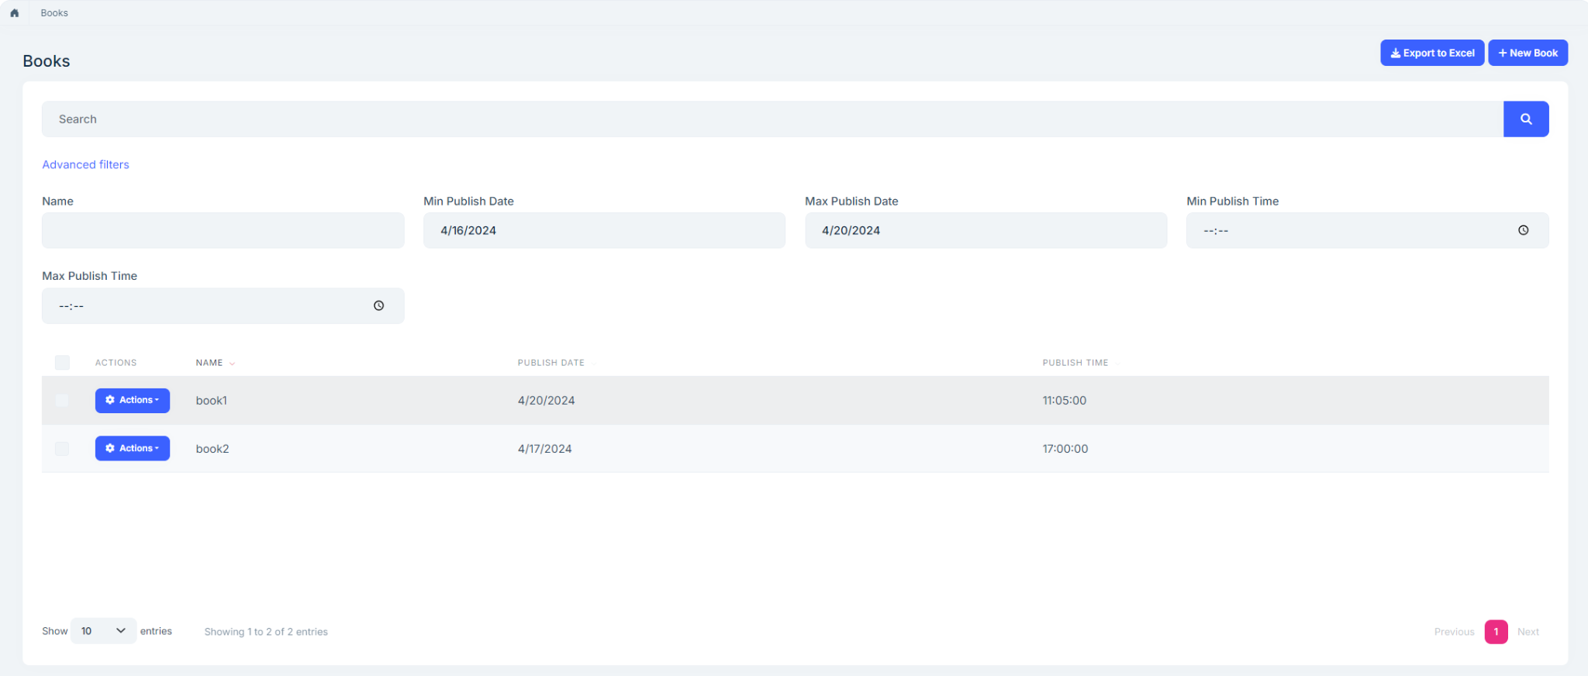

Slide 14
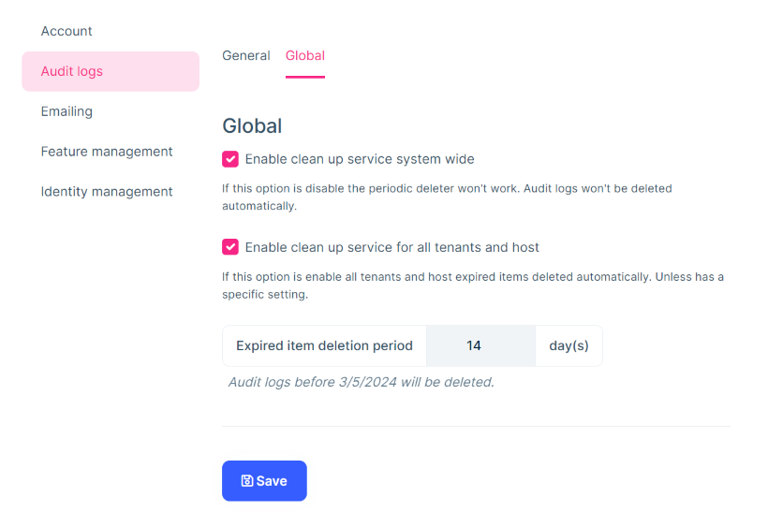
Periodic Log Deletion for Audit Logs
https://docs.abp.io/en/commercial/8.2/modules/audit-logging#audit-log-settings

Slide 15
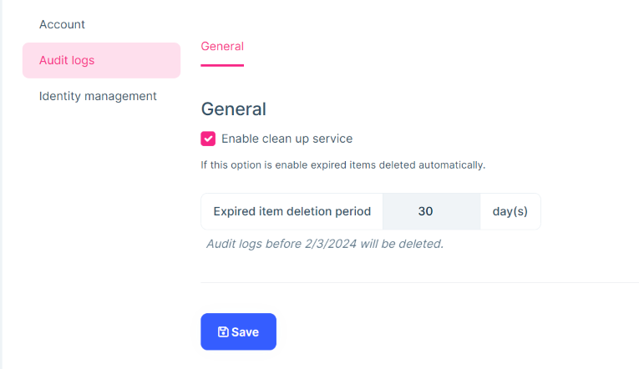
After enabling the system wide clean up service, then you can configure the global “Expired item deletion period” for all tenants and hosts 👉

Slide 16
Migration Guides
ABP Framework 8.x to 8.2 Migration Guide
ABP Commercial 8.x to 8.2 Migration Guide
Migrating to Blazor Web App

Slide 17

Community News

Slide 18
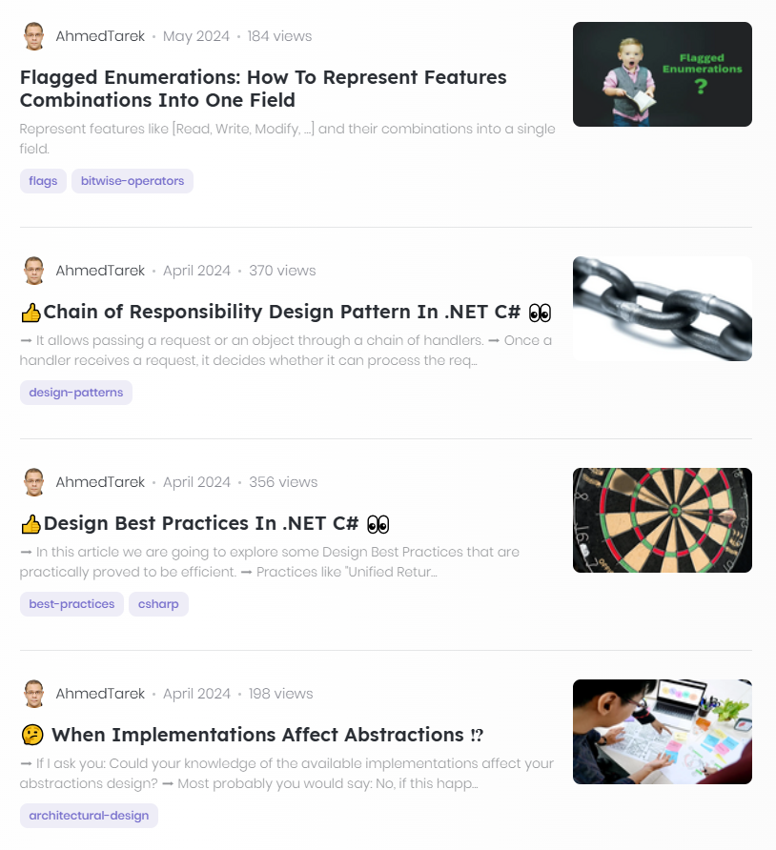
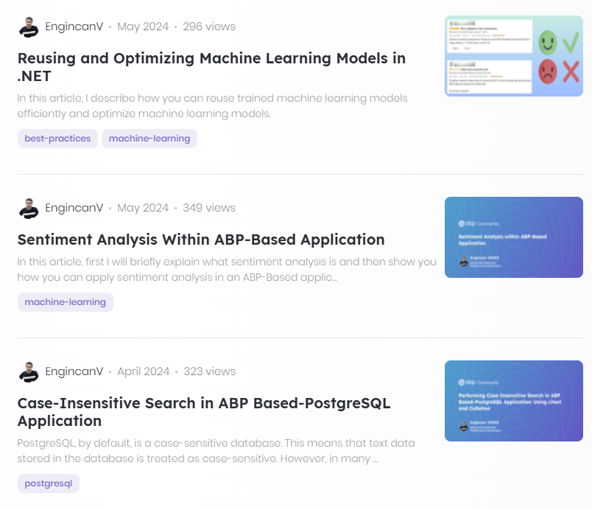
Community Posts

Slide 19


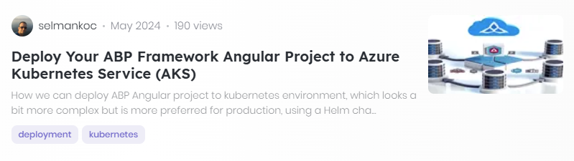
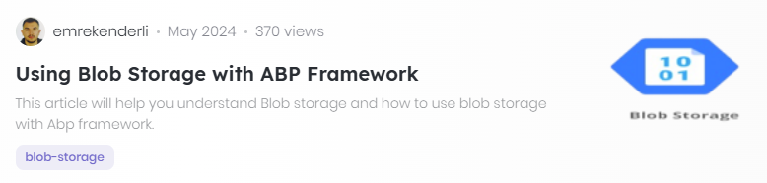
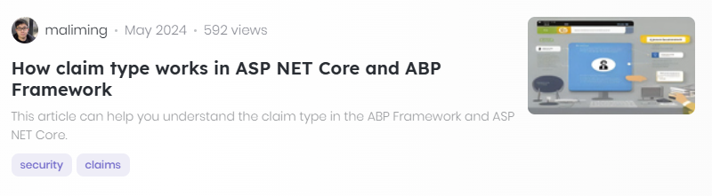

Slide 20
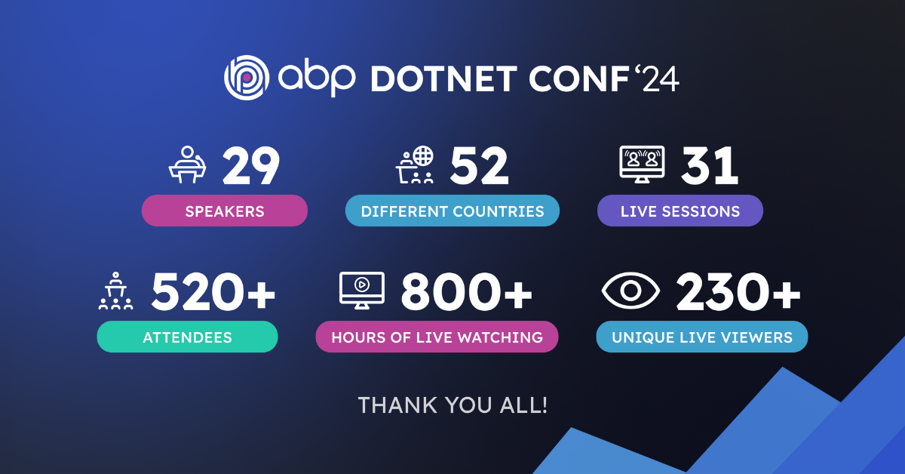
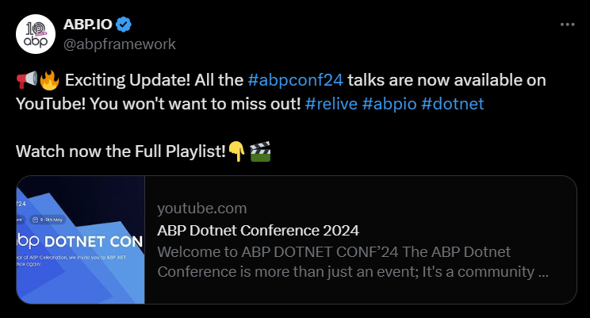
ABP Dotnet Conf 2024
https://www.youtube.com/playlist?list=PLsNclT2aHJcNbSrRbO4K36Pm0Pa8MDC-A
https://blog.abp.io/abp/ABP-Dotnet-Conference-2024-Wrap-Up

Slide 21

DevDays Europe 2024

Slide 22

DevOps Pro Europe 2024

Slide 23


Devnot Dotnet Conference 2024

